Slide 1
Context Clues
The hints that the context gives you about word meanings are called context clues.

Slide 2
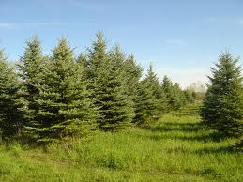
Restatement – A meaning is repeated using different words.
Ex.
Conifers are common in the North Woods. However, not all the trees of this area are evergreens.
Sometimes, a restatement is a synonym, a single word that has the same meaning.
Ex.
Evergreen is a synonym for Conifers.

Slide 3

Apposition- A restatement that appears immediately after the word that it is explaining and is set off by commas.
Sometimes, an Apposition is a whole phrase
Ex.
Conifers, trees that do not lose their leaves in the fall, are common in the North Woods.
Ex.
Conifers, or Evergreens, are common in the North Woods.

Slide 4
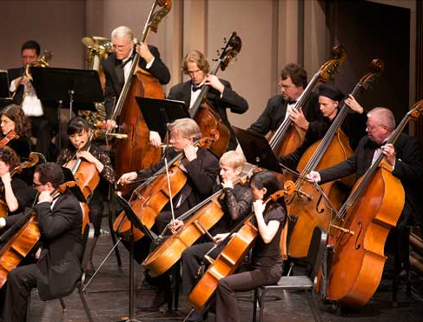
Comparison- Two phrases or sentences that contain parallel, or similar ideas.
Ex.
The first piece the orchestra played was ridiculously sad and mournful. The second piece was likewise lugubrious.
The word likewise, in the example, tells you that the first and second piece are being compared.

Slide 5
Contrast- Two opposite ideas are stated.
Ex.
Jubal’s ideas were not very pragmatic; rather, they were idealistic.
Here, the contrast word idealistic, is an antonym, or a word with a meaning opposite to pragmatic.

Slide 6
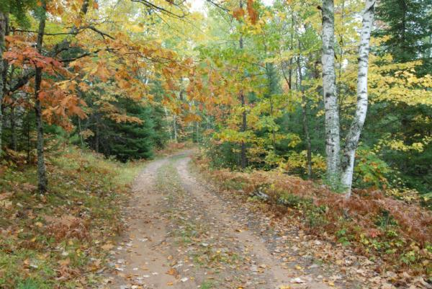
Example- is another way to discover a meaning of a word.
If a passage provides examples of an unfamiliar word, try to figure out what the examples may have in common, and from that you may be able to deduce what the word means.
Ex.
Conifers, such as firs, spruces, pines, and cedars, are common in the North Woods.

Slide 7

Inference – The process of making an educated guess from simply reading the context and asking yourself what meaning would make sense given everything else that the passage tells you.
Ex.
Maria would not be able to see her friends or parents for several months. No wonder she felt melancholic.

Slide 8

Eponym- A person from whose name a word has been created from.
Ex.
Writing the new tax code was a Herculean task.

Slide 9

Base Words- Ordinary words that can be combined into compound words, or to which prefixes and suffixes may be added.
*Moon + Walk = Moonwalk.
Roots- like base words, can be compounded or can be expanded with prefixes or suffixes; roots cannot stand alone.
* In + spec + tion = inspection
Word Parts:
Prefixes- Parts added to the beginning of words.
*Predetermined
Suffixes-Parts added to the ends of the words.
*Merriment

